Slide 1


Slide 2








Slide 3
INTRODUCTIONS
Wing Commander – Col Dan Tulley
Air Show Director – Maj Ryan Garlow
Deputy Director – Lt Col John Schwartz
Air Ops – Lt Col Randy Naylor
Ground Boss – Maj Andy Calhoun
Ramp Coordinator – Buck McLaughlin
Air Boss – George Cline
Narrator – Larry Strain
ATCT – Capt Steve Parent
FAA – Dave Bear

Slide 4
ROLL CALL
Thunderbirds
Rob Holland
Mike Goulian
KC135 Flyby
Jive Kerby
A4
Scott Yoak
Jim Tobul
Randy Ball
  Kirby Chambliss
  RedBull Air Force
  GEICO
  SOCOM
  Larry Labriola

Slide 5
TIME CHECK

Slide 6

MacDill AirFest 2016
WEATHER
6 OSS/OSW
SSgt Tubbs

Slide 7


MacDill 3-Day Forecast
Day
Sun: 19 Mar
A.M.
Mostly Cloudy
Isolated Showers
Winds
NW 5-10KT
P.M.
Partly
Winds
NW 10-15G20KT
High
75°F
Low
68°F
SR / SS
0734L/1942L

Slide 8
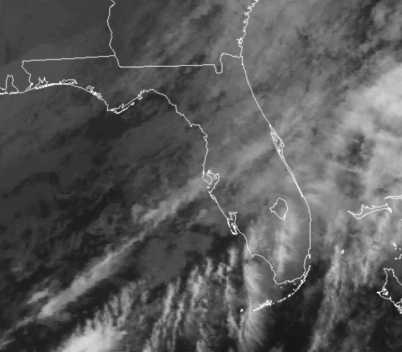
Airspace Weather
CLOUDS
AGL
FL WNDS / TEMP°C
100 | 26030 / +6
050 | 30014 / +11
030 | 30017 / +15
010 | 31019 / +17
SFC | 33016 / +21
400
350
300
250
030 BKN 210
200
150
100
HAZARDS
TSTMS | NONE
TURB | NONE
ICG | NONE
050
010
005

Slide 9
Weather
Status | Airfield | TAF
 | KMCF | TAF AMD KMCF 201025Z 2010/2114 25006KT 8000 BR BKN035 BKN150 QNH2982INS BECMG 2012/2013 25009KT 6000 -SHRA BKN030 BKN100 QNH2983INS BECMG 2015/2016 28012KT 9999 NSW SCT018 BKN030 BKN100 QNH2990INS BECMG 2020/2021 30012G18KT 9999 SCT030 SCT150 QNH2990INS BECMG 2102/2103 30015G20KT 9999 FEW150 QNH3000INS TX24/2020Z TN10/2108Z AMD 201025
 | KTPA | KTPA 200900Z 2009/2106 VRB03KT P6SM VCSH SCT012 BKN120 FM201400 30006KT P6SM VCSH BKN030 FM201700 33006KT P6SM BKN035 FM201900 30012G18KT P6SM BKN050 FM210300 33015G20KT P6SM SCT250
 | KTPF | KTPA 200900Z 2009/2106 VRB03KT P6SM VCSH SCT012 BKN120 FM201400 30006KT P6SM VCSH BKN030 FM201700 33006KT P6SM BKN035 FM201900 30012G18KT P6SM BKN050 FM210300 33015G20KT P6SM SCT250
 | KPIE | KPIE 200808Z 2008/2106 29004KT P6SM VCSH SCT012 BKN120 FM201600 34009KT P6SM VCSH BKN030 FM201900 32015G22KT P6SM BKN040 FM210100 34015G24KT P6SM SCT250
 | KSPG | KPIE 200808Z 2008/2106 29004KT P6SM VCSH SCT012 BKN120 FM201600 34009KT P6SM VCSH BKN030 FM201900 32015G22KT P6SM BKN040 FM210100 34015G24KT P6SM SCT250
CIG/VIS
>3000 / 3
CIG/VIS
>1000 / 1
CIG/VIS <500 / ½
or
XWINDS > 25kts

Slide 10
COMMUNICATIONS
Air Boss Frequency – 120.175
Backup/Stuck Mic Freq. – 118.575
Discrete Frequency – 123.15

Slide 11
COMMUNICATIONS
MCF AFB ATCT
  Local Control 120.175/294.7
  Ground Control – 118.575/275.8
  ATIS – 133.825/270.1
TPA ATCT
  Approach – 124.95/135.5/354.0
  Departure – 119.65/119.1/118.8/134.25

Slide 12
AIRSPACE
Air Space – SFC to 15,000 AGL – 5NM Radius of the Airport
Field Elevation- 14’
Runway – 04/22 (11421 x151),
Waiver Times – 0900-1700 Local
TFR Times – 1000-1800 Local
Class Air Space – “D” SFC to 1600
Holding/Divert Area – 1000 AGL behind the crowd Area
Birds In Area
Barriers

Slide 13
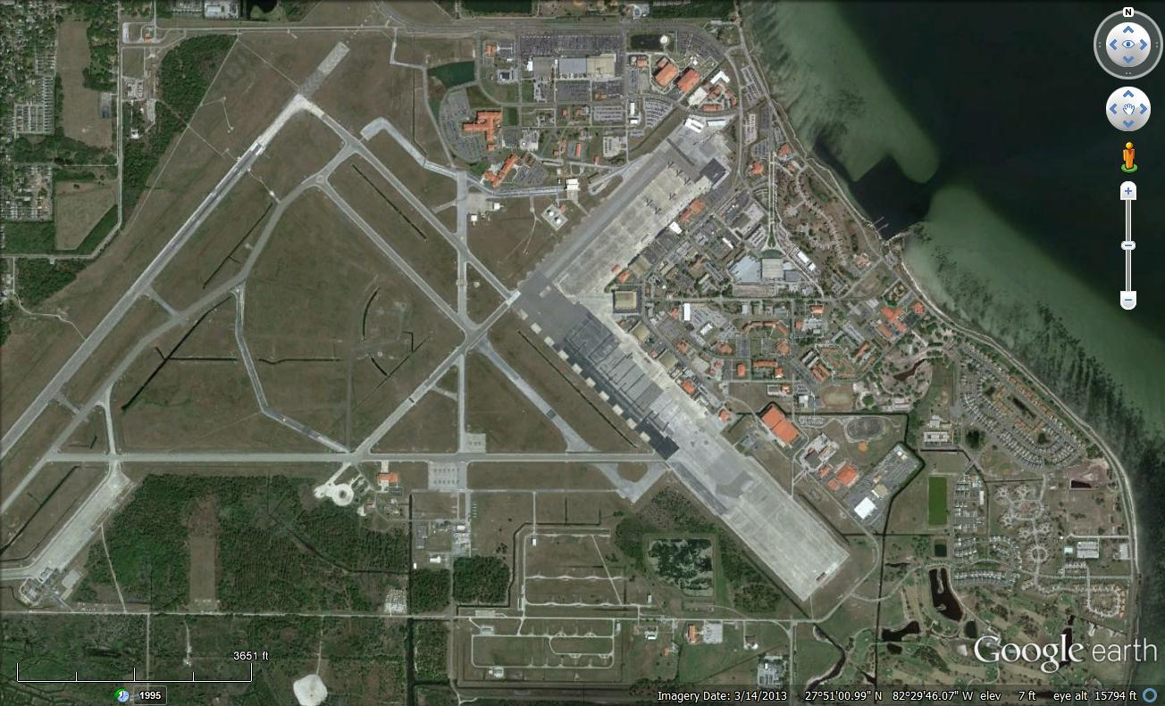
Not to Scale
Holding Area
ARFF
Corner Markers
Crowd Area
PLA
Bomb Burst
ARFF
500’
Control Point
1500’
Thunderbird Parking
Show Center
Aerobatic Box

Slide 14
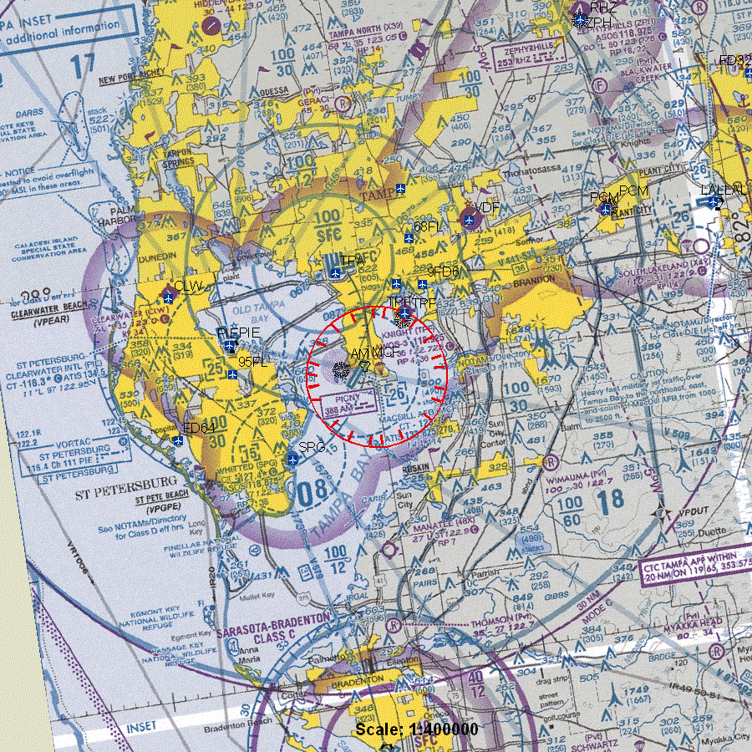

Slide 15
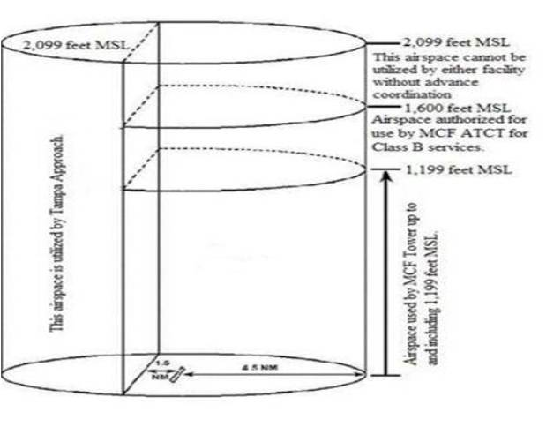

Slide 16
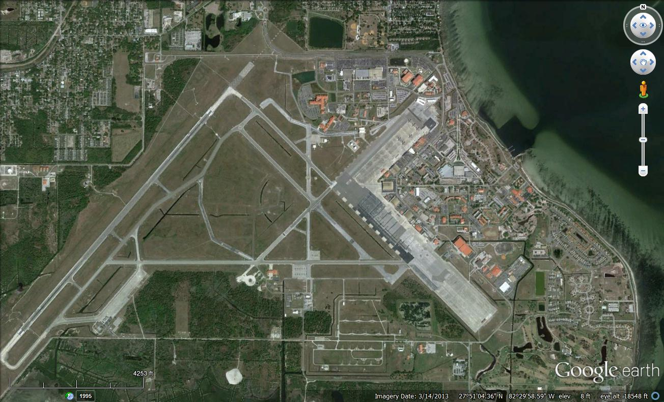
Not to Scale
Thunderbird Aerobatic Box

Slide 17
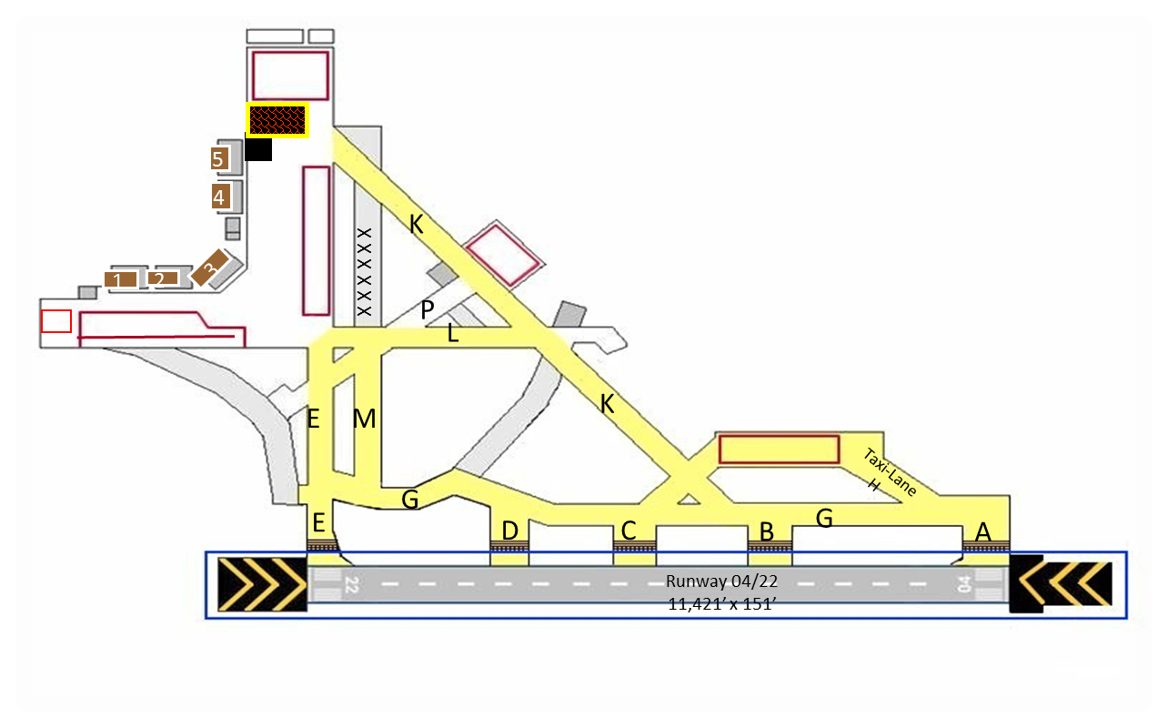
3500’
M
1500’
1500’

Slide 18
GROUND OPERATIONS
Be at your Aircraft at least (2) acts ahead of your act
Follow the SCHEDULE not the timeline, the timeline is only a guide
If you need Smoke Oil/Fuel, coordinate with the Ground Ops (Buck) ASAP, after the briefing is a good time to top off
If you are not getting what you need, call the AirBoss
If you have a Mechanical, please advise ASAP
Essential Personnel only in the Sterile/Restricted Area!!

Slide 19
EMERGENCIES
Fly your Air Craft first and then advise the Air Boss ASAP of your condition
In Case of a Emergency, the Airport will be returned to the ATCT after the AirBoss sends out AARF and they will implement the Airport Emergency Plan and the “Incident Commander” will assume control
If you observe a vehicle with flashing lights on the runway, or a Light Gun Signal from the Tower, DIVERT
The initial Divert/Holding Area is located behind the crowd at 1,000 AGL and await further instructions from the Air Boss

Slide 20
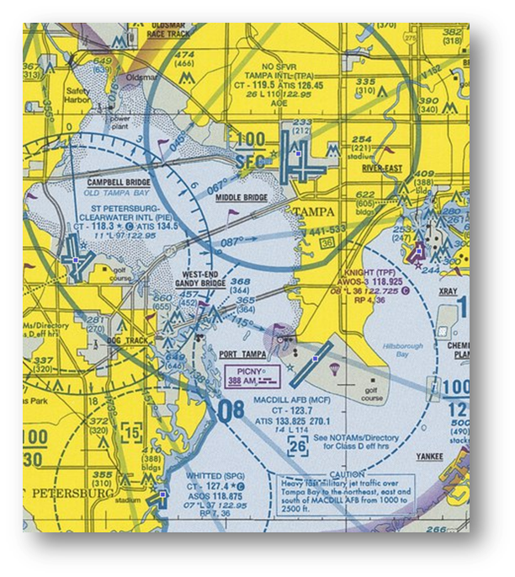
EMERGENCIES
TPA
Divert Locations
  TPF- Peter O Knight (5NM NE)
  SPG – Albert Whitted (8NM SW)
  TPA – Tampa International )8NM N)
  PIE – St Petersburg-Clearwater (10NM W)
Deteriorating Weather – Minimum is 1500/3
  Recall/Determination by the Air Boss/FAA IIC
Communication Failure/Stuck Microphone
  Fly your show, airspace will be protected
Everyone Use Caution…Be Heads Up…And Follow Instructions
PIE
TPF
MCF

Slide 21
EMERGENCIES
Please advise the Emergency Personnel of any SPECIAL instructions about your Aircraft
  Where is the Best place to lift your aircraft
  Where are the Best entry points in the case of an accident
  Do you have Ejection Seats? If so identify the aircraft to Emergency personnel
  Discuss any Special needs of your aircraft with the Emergency personnel
Share your Knowledge, it may be your Lifeline

Slide 22

PARACHUTIST
NO vehicular or personnel near the Jump Area (PLA)
NO props turning with 1,000 feet of the Jump Area (PLA)
If you are the act following the Jump Team, call the Air Boss prior to starting your engine
Ask if you are not sure!!!

Slide 23
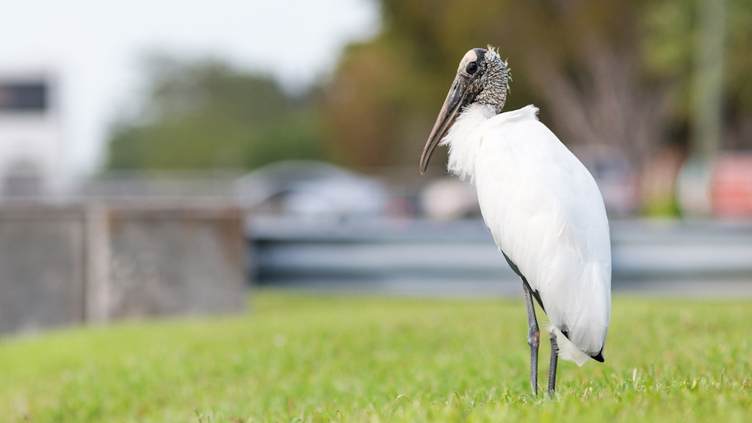
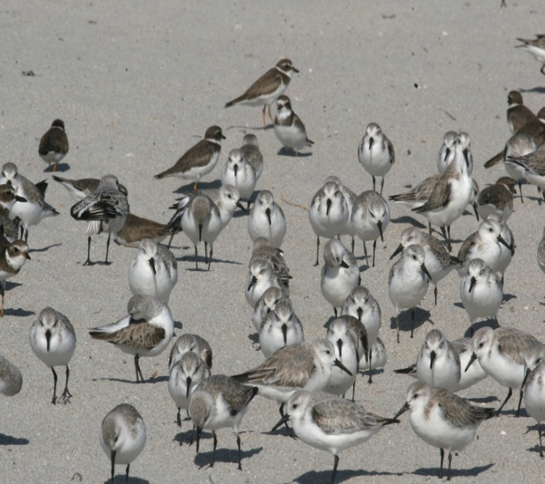
BASH Wildlife Hazards
  Shorebirds (Small)- Following rainstorms, groups of 100 to 300 loafing on all pavement areas, especially near approach of Runway 04.
    Between 0 AGL to 500 AGL
  Wading birds (Large)- egrets/herons/wood storks
    Individuals loaf on ground in drainages throughout airfield
    Between 0 AGL to 500 AGL

Slide 24
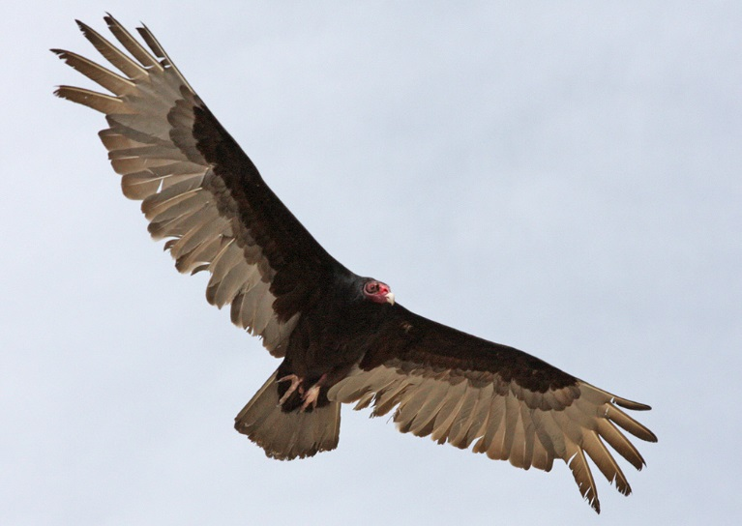
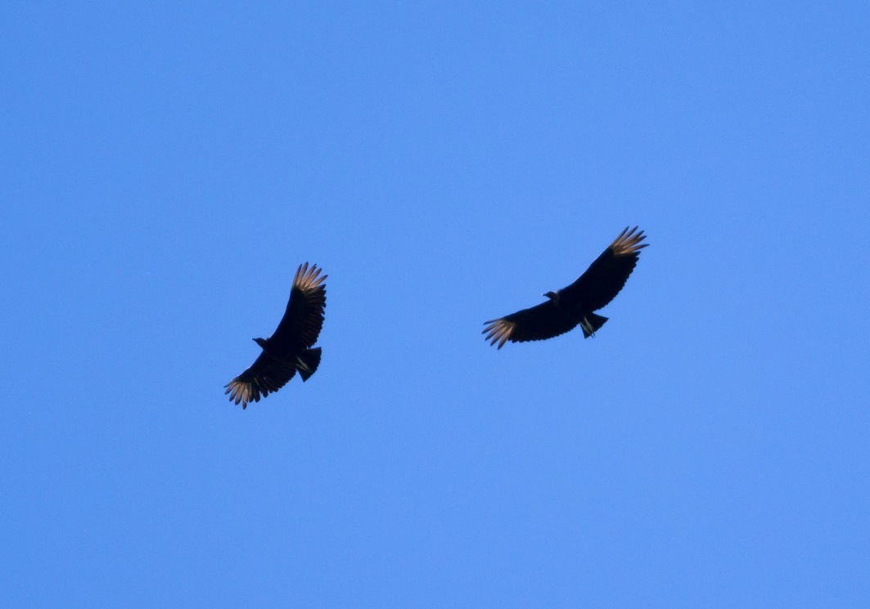
BASH Wildlife Hazards
  Vultures (Large)
    Low densities of vultures for the past few weeks
    Expect groups of 1 to 10 vultures around the tree line along Runway and occasionally throughout the airspace, riding thermals.
    Rainy weather = fewer vultures in the air.
    Between 0 AGL to 1500 AGL on clear days.

Slide 25
AIR SHOW SCHEDULE
Schedule….
All Performers Must Sign the Waiver/or Participants Briefing Sheet Prior to performing

Slide 26
WAIVER REVIEW
Photo/Banana/Arc passes must use the 500’ Show line for all aircraft
Must Use the Corner Markers
No aircraft lower than 100’ AGL when operating on or beyond the 500’ Show line, unless you have a surface level waiver
Clearance of Clouds is waived within the TFR
Maximum Speed is waived, NO SUPERSONIC!!

Slide 27
BRIEFING REVIEW
NOTAM
WAIVER
EMERGENCIES
AIRSHOW SCHEDULE
ZERO ALTIMETERS
SQUAWK 1200
DO NOT LEAVE HERE WITH ANY QUESTIONS!!!
WE DECONFLICT HERE AND NOW!!!
“KNOCK IT OFF”

Slide 28
SAFETY ISSUES
Everyone here is a “Safety Official”
We all need to
  Ask
  Look
  Listen
  Act
Everything should be Routine
Please Speak Up!!

Slide 29
HUMAN FACTORS
“Over 80% of ALL accidents in aviation involve human error”
Lack of Communication
Lack of Teamwork
Fatigue
Lack of Resources
Pressure
Lack of Assertiveness
Stress
Lack of Awareness
Norms
Complacency
Lack of Knowledge
Distraction
“The Dirty Dozen”
Which of these could you experience
that might effect your performance?
And, what can you do about it?

Slide 30
HUMAN FACTORS
Apply Risk Management
  Don’t accept Unnecessary “RISK”
  Use good Judgment and Air Sense,
  Be Responsible, “Get Yourself Prepared” Preserve 30 min bubble
  Avoid “Outside Distractions” Delegate
Safety is “Everyone’s Job!!”
Make an “Individual Commitment” to apply good safety techniques

Slide 31
THE BIG PICTURE
SAFE AIR SHOW
and
ZERO MISHAPS

Slide 32
COMMENTS/QUESTIONS
FAA - IIC
ATCT
NARRATOR
GROUND OPS
EMERGENCY PERSONNEL
SECURITY
SAFETY
BASE OPS
PUBLIC AFFAIRS
AIR OPS DIRECTOR
AIR SHOW DIRECTOR
WING COMMANDER

Slide 33
TOMORROW’S BRIEFING
Sunday
08:00 AM
SAME LOCATION

Slide 34
Don’t Forget to Turn Your Cell Phones Back On

